Slide 1
STATISTICAL GROWTH ANALYSIS
Group Members Section-F
Hermain Qadir 19K-1517
Sameer Khan 19K-1484
Anusha Saad 19K-0281

Slide 2
Introduction
This application will assist to make conclusions about which company/organization is doing better in a particular department by comparing different data sets. It will derive mathematical results like mean, median, variance, standard deviation, outliers from given data sets to show the growth/output. Our proposed system will make use of deep learning models to compare and contrast data by first implementing data structures like linked lists, stacks, queues, and trees and use these to perform calculations based on deep learning.

Slide 3
Project Specifications
Mean
Slope/gradient
Standard Deviation
Comparison to predict successive years growth/budget
Compare growths of different branches
Comparison on departmental sales of each branch
Cumulative Frequency

Slide 4
Tools and Techniques
IDE - Visual Studio Code
Console based application

Slide 5
Features of Data and Programming Tools
Data Structures used – linked lists and arrays (1-dimensional and 2-dimensional)
Object Oriented Programming
File Handling
Pointers
Sorting
Libraries – cmath, iomanip, conio.h

Slide 6
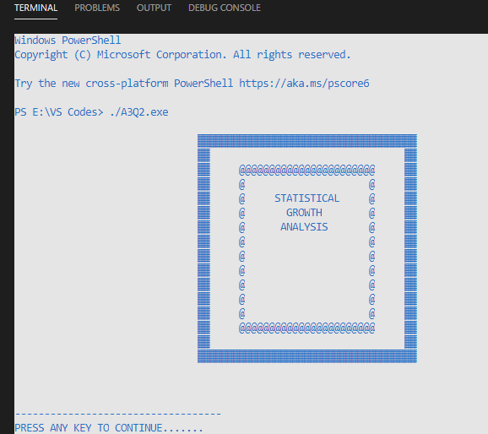
Input-Output Screenshots

Slide 7
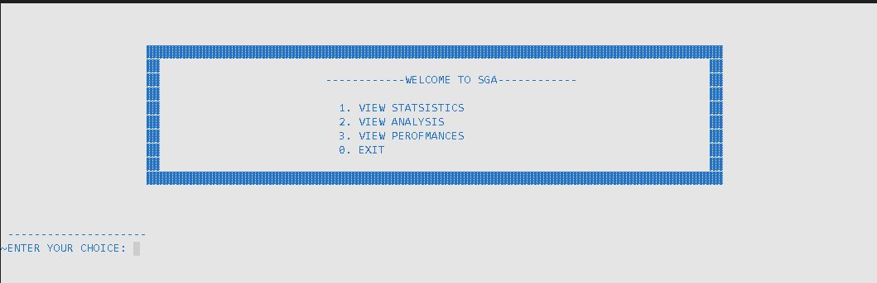

Slide 8
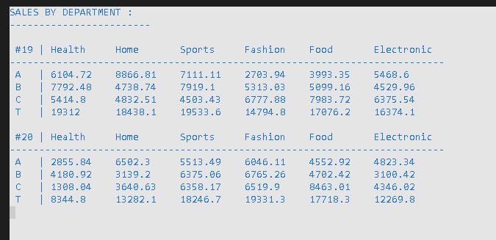

Slide 9
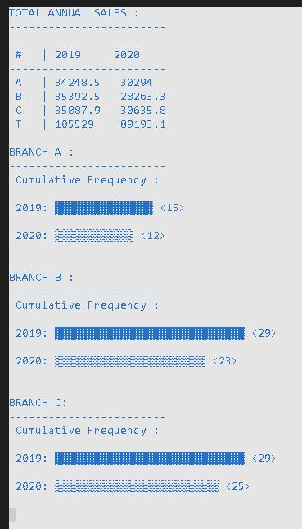

Slide 10
